Slide 1

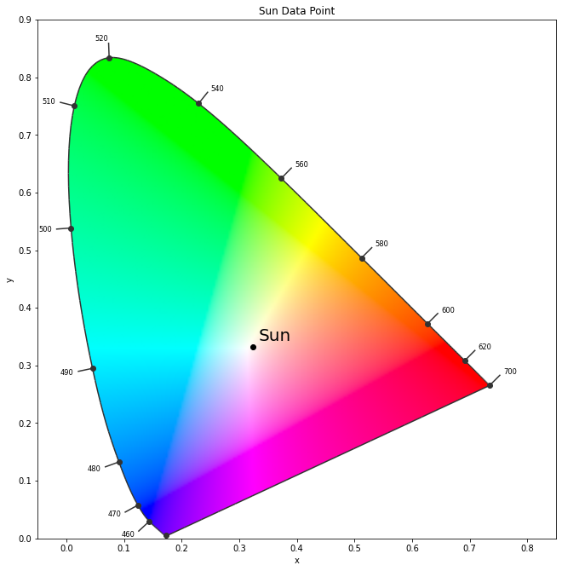
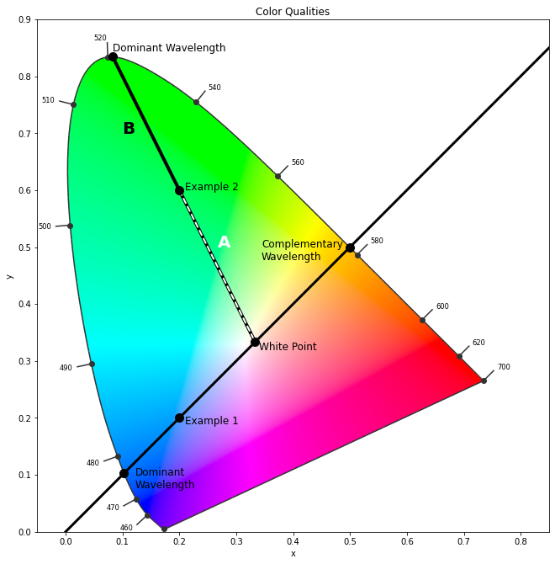
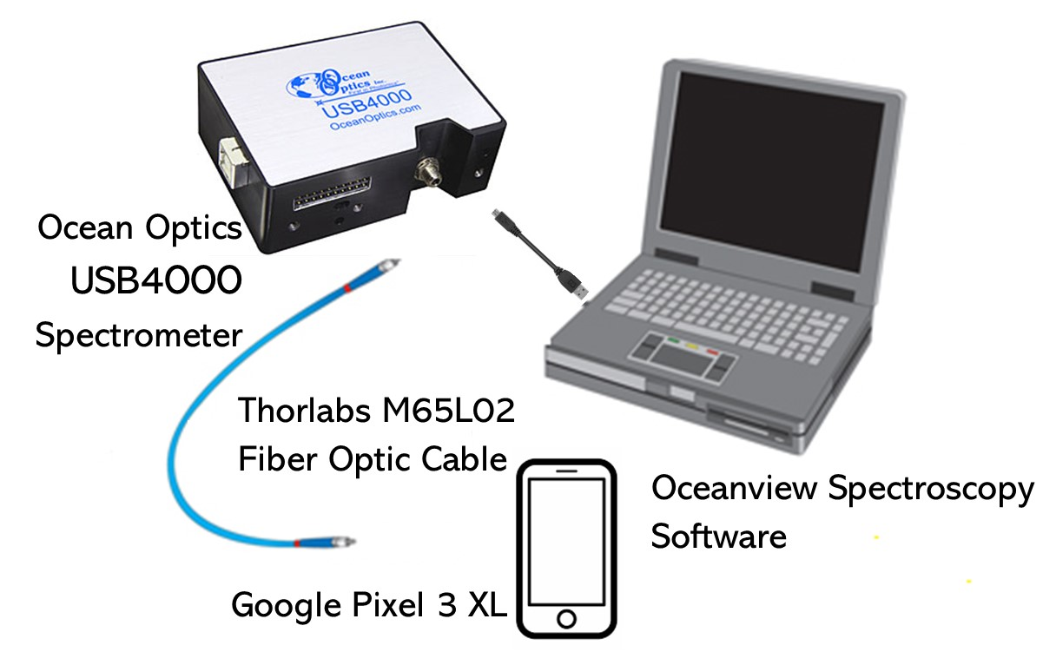
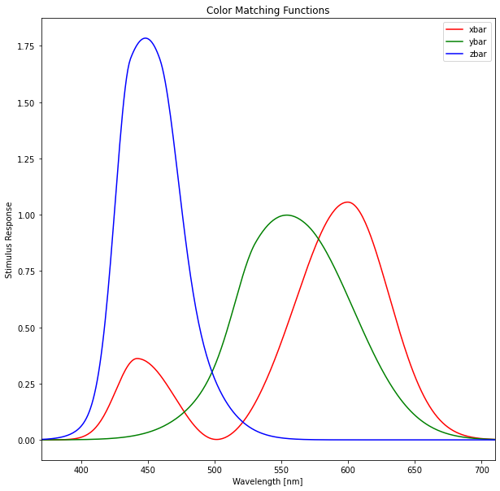


Light Emission from Cell Phones: Spectrum Analysis
PY 452
Ryan Branagan, Jared Kempton, Dali Sun
Objectives
Methods
This project aims to investigate the spectrum of the electroluminescence emission collected from the cell phones using an ocean-optics spectrum analyzer. The purity of the color spectrum would be analyzed using a python script, by which the color coordinates will be determined.
The dominant and complementary wavelength are found by drawing a line between the xy coordinate and the “white point”. The white point is the point chosen to be white light
The colorful graph on the left shows the xy color space. It is bound by the spectral locus comprised of points belonging to monochromatic light, light of a single wavelength. Anything inside the boundary is a combination of various wavelengths of light. The bottom line is called the line of purples and does not have a single wavelength but is a mixture of red and blue.
In order to get an xy coordinate we need to calculate XYZ values. This is done by integrating the spectra with each color matching function. The color matching functions represent the response of the eye to different wavelengths, and are similar to the response curves of the long, medium, and short cones in the eye
To create our python script we started with simple data from the sun. We plotted this on a color map which showed the color of the sun as white; which is to be expected.
corresponding to equal intensity of all wavelengths. The boundary closest to the data point is the dominant wavelength and the other side is the complementary wavelength. To calculate the color purity we take the ratio of the distance A/B between the dominant wavelength and the white point, and the xy coordinate and the white point.
Results
We analyzed light at 50%, 75%, 100% brightness and with blue light/night mode on. The brightness makes no sense but with the blue light filter we see the point move away from the blue region. The purity of the color spectra was preserved and the color purity was found using the distance A/B. The purity appears to be decent.
Conclusions
References
We notice that the data for cyan and green for all blue light/night mode is not entirely cyan and green and is shifted away from blue, which means that the filter is taking blue light out, and is working as advertised. The data for blue shifts more towards blue, which means that the filter is not working and will need improvements in the future.
Color Matching Function—An overview | ScienceDirect Topics. (2020). Retrieved October 22, 2020, from https://www.sciencedirect.com/topics/engineering/color-matching-function
Measuring radiometric spectra and CIE color space of light sources with the FLAME spectro-radiometer — Spectrecology. (n.d.). Retrieved October 22, 2020, from https://www.spectrecology.com/flame-spectrometer/
Standard Solar Spectra. (n.d.). Retrieved October 23, 2020, from https://www.pveducation.org/pvcdrom/appendices/standard-solar-spectra
Wyman, Chris; Sloan, Peter-Pike; Shirley, Peter (July 12, 2013). "Simple Analytic Approximations to the CIE XYZ Color Matching Functions". Journal of Computer Graphics Techniques. 2 (2): 1-11. ISSN 2331-7418.
Wyszecki, Günter & Stiles, Walter Stanley (2000). Color Science: Concepts and Methods, Quantitative Data and Formulae (2E ed.). Wiley-Interscience. ISBN 0-471-39918-3.
Notes:
Title Idea:
Measuring a Phone Screen to Determine LED Quality

Slide 2
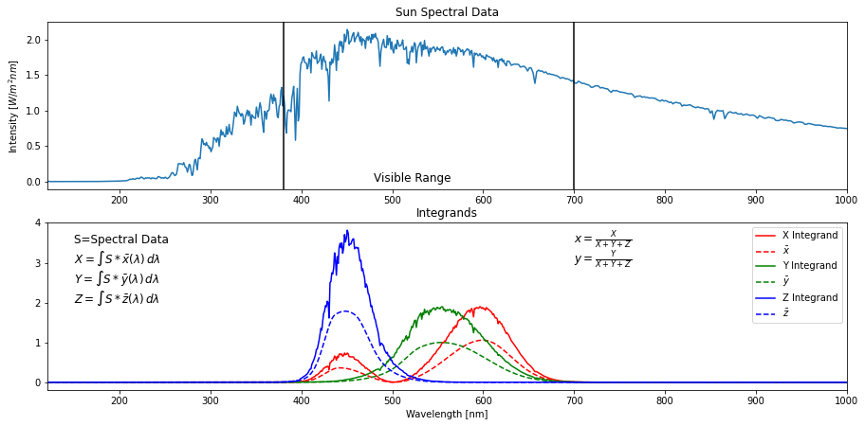


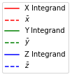
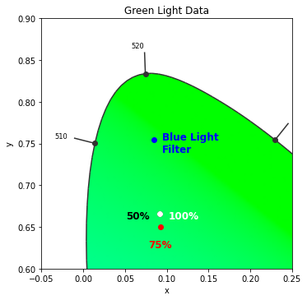
Light Emission from Cell Phones: Spectrum Analysis
PY 452
Ryan Branagan, Jared Kempton, Dali Sun
Objectives
Methods
This project aims to investigate the spectrum of the electroluminescence emission collected from the cell phones using an ocean-optics spectrum analyzer. The purity of the color spectrum would be analyzed, by which the color coordinates will be determined.
0.9
Sun Data Point
Color Qualities
The dominant (1) and complementary (2) wavelength are found by drawing a line between the xy coordinate and the “white point”. The white point is the point chosen to be white light
0.8
The colorful graph on the left shows the xy color space. It is bound by the spectral locus comprised of points belonging to monochromatic light, light of a single wavelength. Anything inside the boundary is a combination of various wavelengths of light. The bottom line is called the line of purples and does not have a single wavelength but is a mixture of red and blue.
1
A
B
B
2
Ex. 1
A
Ex. 2
0.4
Sun
Sun Spectral Data
y
White
Point
1
Intensity
[W/(m^2)nm]
CP(3) = A/B
0.0
0.0
0.4
0.8
x
Visible Range
corresponding to equal intensity of all wavelengths. The boundary closest to the data point is the dominant wavelength and the other side is the complementary wavelength. To calculate the color purity (3) we take the ratio of the distance A/B between the dominant wavelength and the white point, and the xy coordinate and the white point.
To create our python script we started with simple data from the sun. We plotted this on a color map which showed the color of the sun as white; which is to be expected.
Integrands
Results
200
300
400
500
600
700
800
900
1000
Wavelength [nm]
0.9
Green Light Data
Conclusions
References
Green Light Data | 50% | 75% | 100% | Blue Light Filter
xy | (0.091 , 0.665) | (0.093 , 0.650) | (0.092 , 0.665) | (0.084 , 0.755)
Dominant Wavelength | 511.030 | 510.197 | 511.064 | 516.079
Color Purity | 76.8% | 75.5% | 76.7% | 86.6%
520
We notice that the data for cyan and green for all blue light/night mode is not entirely cyan and green and is shifted away from blue, which means that the filter is taking blue light out, and is working as advertised. The data for blue shifts more towards blue, which means that the filter is not working and will need improvements in the future.
Color Matching Function—An overview | ScienceDirect Topics. (2020). Retrieved October 22, 2020, from https://www.sciencedirect.com/topics/engineering/color-matching-function
Measuring radiometric spectra and CIE color space of light sources with the FLAME spectro-radiometer — Spectrecology. (n.d.). Retrieved October 22, 2020, from https://www.spectrecology.com/flame-spectrometer/
Standard Solar Spectra. (n.d.). Retrieved October 23, 2020, from https://www.pveducation.org/pvcdrom/appendices/standard-solar-spectra
Wyman, Chris; Sloan, Peter-Pike; Shirley, Peter (July 12, 2013). "Simple Analytic Approximations to the CIE XYZ Color Matching Functions". Journal of Computer Graphics Techniques. 2 (2): 1-11. ISSN 2331-7418.
Wyszecki, Günter & Stiles, Walter Stanley (2000). Color Science: Concepts and Methods, Quantitative Data and Formulae (2E ed.). Wiley-Interscience. ISBN 0-471-39918-3.
y
0.75
510
0.6
0.0
0.1
0.2
x
Notes:
Title Idea:
Measuring a Phone Screen to Determine LED Quality

